Slide 1
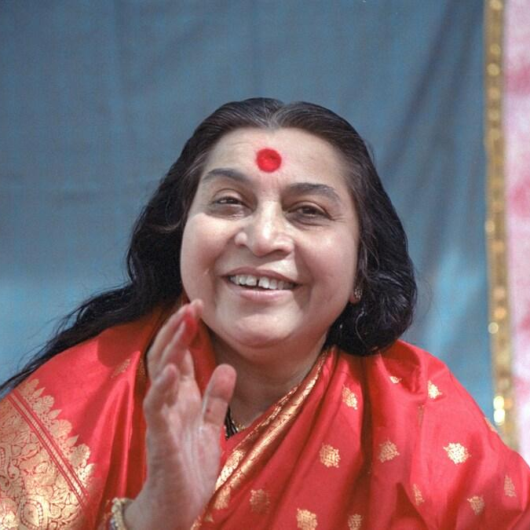

Introduction to Sahaja Yoga
Grade 1, Nirmala Vishwa Vidya Peetham (Home School) https://nirmalavishwavidyapeetham.org/
Shri Mataji Nirmala Devi - The founder of Sahaja Yoga meditation
Notes:
Hi! My name is Virata Pusuluri! In this presentation, I am going to give a short introduction to Sahaja yoga. I will explain about Sahaja Yoga, Kundalini energy, and about Self-Realization.

Slide 2
What is Sahaja Yoga?
In the words Sahaja Yoga, ‘Saha’ means ‘with’, ‘Ja’ means ‘born’, and ‘Yoga’ means union or connection with the universal energy or God or Mother Nature.
Sahaja yoga helps us easily awaken our inner energy called Kundalini to achieve this union and physically feel it as a cool breeze through a process called self-realization.
It is very simple and anybody can feel this experience.
By practicing “Sahaja Yoga” meditation, we can always be joyful and peaceful, and achieve the highest state of human life.
Sahaja yoga is always free and is practiced in several countries around the world.
Shri Mataji Nirmala Devi is the founder of “Sahaja Yoga” meditation and has given this gift to humanity.
Shri Mataji Nirmala Devi - the founder of Sahaja Yoga meditation
Notes:
Sahaja Yoga is a simple way to awaken our inner energy, the Kundalini, which gives us a connection to the universal energy around us which can be felt physically as a cool breeze—this is called Self-Realization. "Saha" in "Sahaja" means "with" and "ja" means "born " and "yoga" means "union with the universal energy". This is a simple technique which is free and practiced across the world. It can help us achieve peace, joy, and the highest state of human life. Shri Mataji Nirmala Devi is the founder of Sahaja Yoga meditation who gave this beautiful gift to humanity.

Slide 3
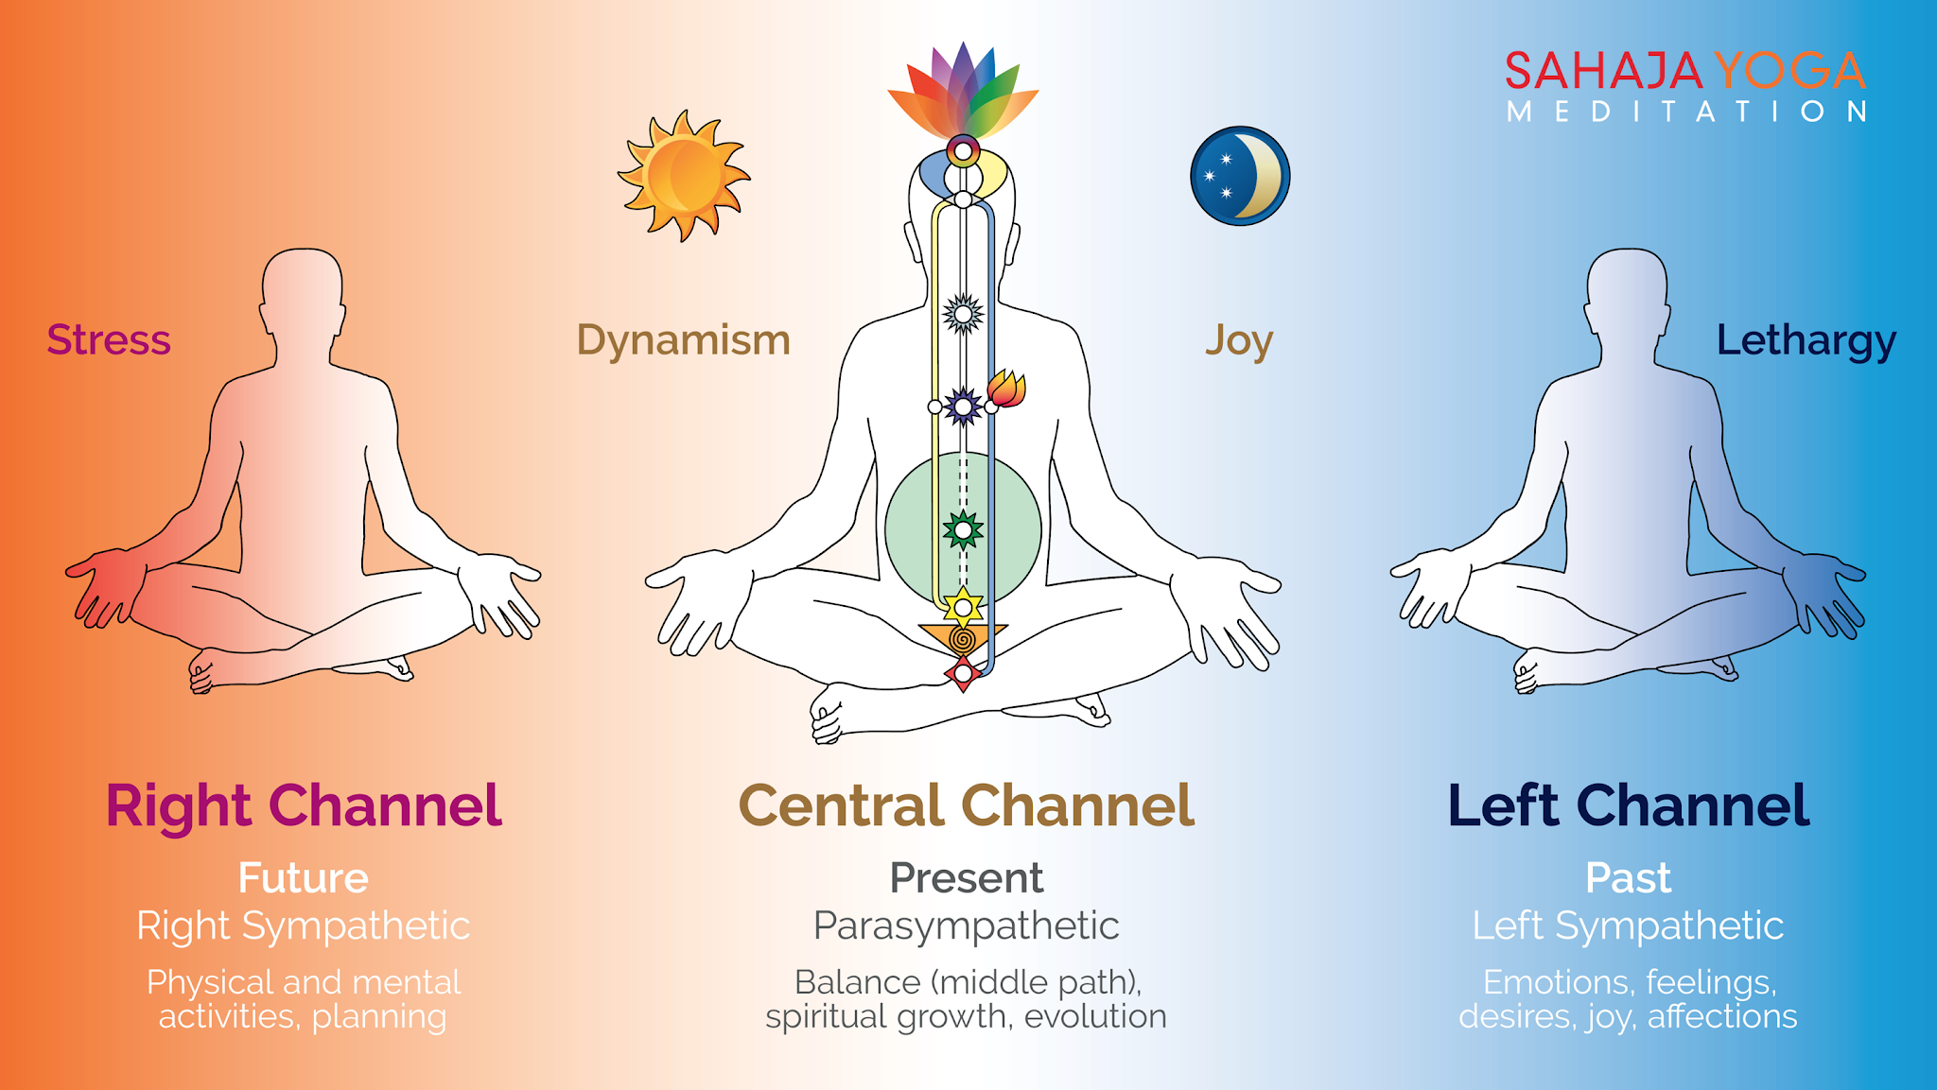
Chakras and Channels
Chakras:
Chakras are like energy centers located near different parts of our spinal cord, and control our physical and mental states.
There are seven chakras in our body:
Mooladhara, Swadhisthana, Nabhi (Void), Anahata, Vishuddhi, Agnya, and Sahastrara.
Each chakra helps maintain different emotional and mental qualities. It also takes care of physical organs around it.
When our chakras are in balance, we will be healthy physically and mentally.
Sahaja Yoga guides us on how to take care of our seven chakras.
Notes:
Our body has an inner system of energy. Chakras are like energy centers along the spine that control our physical and mental states. There are seven main chakras each of which help control various physical organs. These chakras are Mooladhara (which is below the Kundalini energy), Swadhisthana, Nabhi, Anahata, Vishuddhi, Agnya, and Sahastrara. Sahaja Yoga teaches us how to balance them. When these centers are balanced, we achieve physical and mental health.

Slide 4
Chakras and Channels
Channels:
There are 3 Channels within us which control our past, present and future activities.
Left channel or Moon channel (Past) – takes care of our desires, emotions and feelings (shown in blue)
Right channel or Sun channel (Future) – takes care of our planning, physical and mental activities (shown in yellow)
Center Channel (Present) – takes care of our spiritual growth and maintaining balance (shown in white)
Notes:
Our body has an inner system of energy. Chakras are like energy centers along the spine that control our physical and mental states. There are seven main chakras each of which help control various physical organs. These chakras are Mooladhara (which is below the Kundalini energy), Swadhisthana, Nabhi, Anahata, Vishuddhi, Agnya, and Sahastrara. Sahaja Yoga teaches us how to balance them. When these centers are balanced, we achieve physical and mental health.

Slide 5
Self-Realization
Kundalini energy:
Kundalini energy is motherly energy inside us.
It is at the bottom of the spinal cord in a triangular bone called sacrum bone.
It stays in a dormant state.
Self-Realization:
When our Kundalini energy rises and passes through all the chakras, it reaches the chakra on top of our head and gets connected to the divine energy around us. This is called Self-Realization.
We can feel this in our hands, and on top of our head as a cool breeze.
Notes:
The Kundalini is a motherly energy, resting in a coiled state at the base of the spine, in the sacrum bone. Self-Realization is when this Kundalini energy rises through all the chakras to the top of the head, connecting us with the divine energy around us. We experience this union physically as a cool breeze on our hands and above the head.

Slide 6
Benefits
When we practice Sahaja Yoga meditation everyday morning and evening (around 5 to 10 minutes), and meditate in a group (called as collective meditation) at least once a week, it helps us in many ways:
The main benefit is that we will be always connected to God, or the Universal energy.
It cures physical, mental, and emotional problems.
It makes us peaceful and always keeps us in balance.
It balances our chakras which improve the qualities associated with those chakras within us. For example, when the swadisthana (2nd chakra) gets balanced, our creativity improves (and reflects in various forms such as singing, dancing, painting, etc.)
It gives us good health, and happiness.
It teaches us to help each other and enjoy as a group.
It makes us free from stress and tensions.
Notes:
Practicing Sahaja Yoga meditation daily brings many benefits. The main benefit is the constant connection to the Universal energy which helps cure physical, mental, and emotional problems, bringing us peace and balance. Balancing the chakras enhances our inner qualities—for example, a balanced Swadisthana chakra improves creativity. Ultimately, it gives us good health, happiness, freedom from stress, and a spirit of collective enjoyment.

Slide 7
Primordial Masters
Primordial masters (or Adi Gurus) are born at different times and taught us the principles to lead a dharmic life.
They also described about the experience and importance of self-realization
Below are the 10 primordial masters, as described by Shri Mataji:
1. Raja Janaka (~5000 BC, Nepal) | 2. Abraham (~1800-1600 BC, Mesopotamia)
3. Moses (~1300 BC, Egypt) | 4. Zarathusthra or Zoroaster (~630 BC, Persia)
5. Lao Zi or Lao Tzu (600-500 BC, China) | 6. Confucius (~551 BC, China)
7. Socrates (~470 BC, Greece) | 8. Prophet Muhammad (~570 AD, Mecca)
9. Guru Nanak (1469 AD, Punjab in Pakistan) | 10. Sainath (~1854 AD, India)
Notes:
Primordial Masters taught us principles for a righteous, or dharmic, life and explained the importance of Self-Realization. There are 10 Primordial Masters whose stories and teachings are essential to follow. They are (tell the names form the slide)

Slide 8
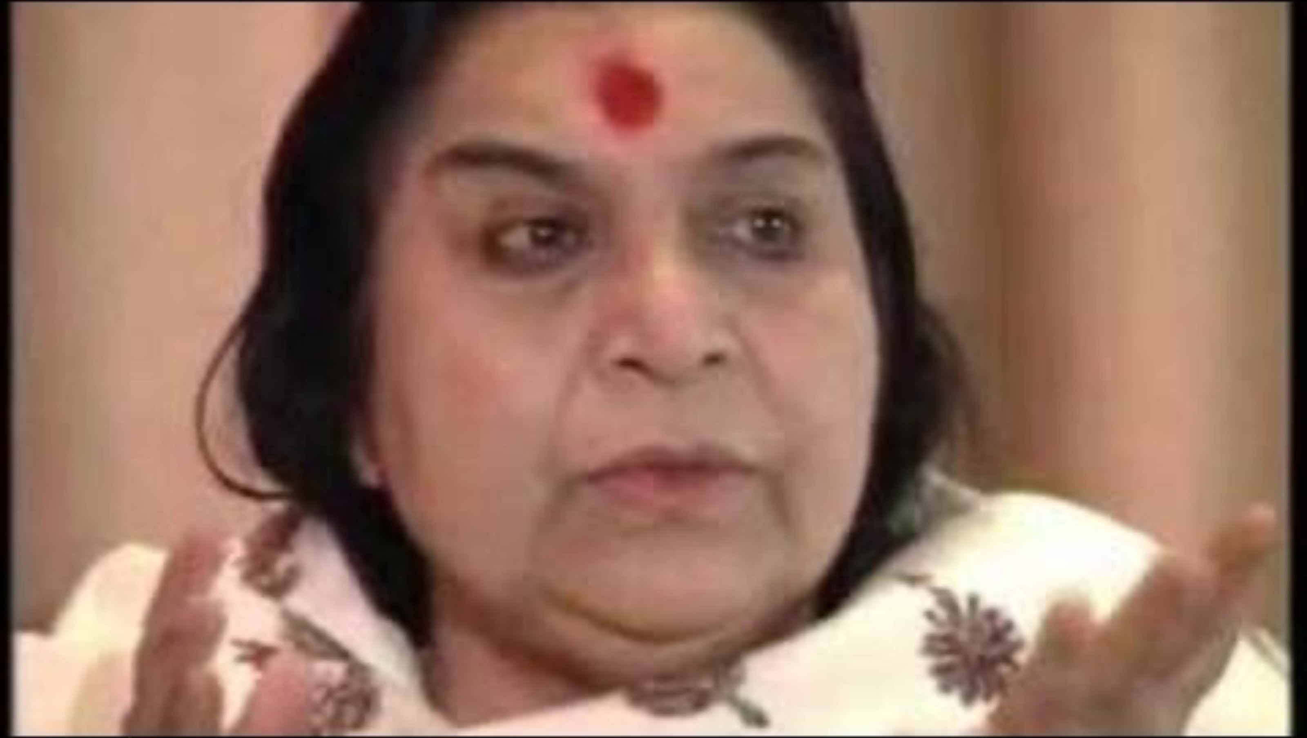
Experience Self-Realization by Shri Mataji
Notes:
In this slide, Shri Mataji , the founder of Sahaja Yoga guides us on how to attain our self-realization

Slide 9
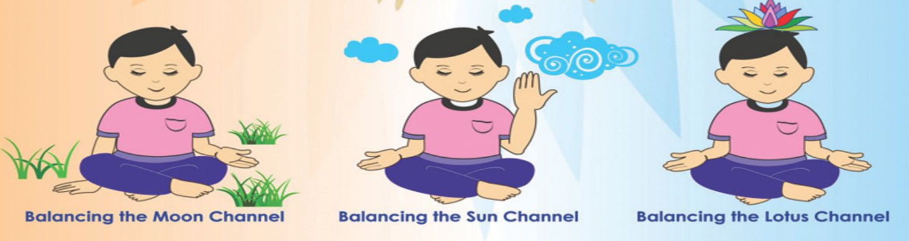
Daily meditation
We can follow these simple steps to remove imbalances and then sit in silent meditation for a few (~10) minutes to feel the cool breeze and peacefulness. This is called Meditation.
Mother Kundalini, please balance my Left channel
Mother Kundalini, please balance my Right channel
Mother Kundalini, please keep me in the present. Please give me self-realization.
Notes:
After we get our Self-realization, we need to meditate everyday to maintain this balance.
We can follow simple steps to balance our inner system before sitting in silent meditation by closing our eyes and placing our hands as shown in the picture.
To balance our left channel, we place our left palm open on our lap and right hand on Mother Earth and say the affirmation Mother Kundalini, please balance my Left channel,"
To balance our right channel, we place our right palm open on our lap and raise our left hand towards the sky, facing backwards say "Mother Kundalini, please balance my Right channel,"
Finally to balance our center channel, we place both our palms on our lap and say "Mother Kundalini, please keep me in the present. Please give me self-realization."
We can then sit and meditate silently for about 10 minutes.

Slide 10
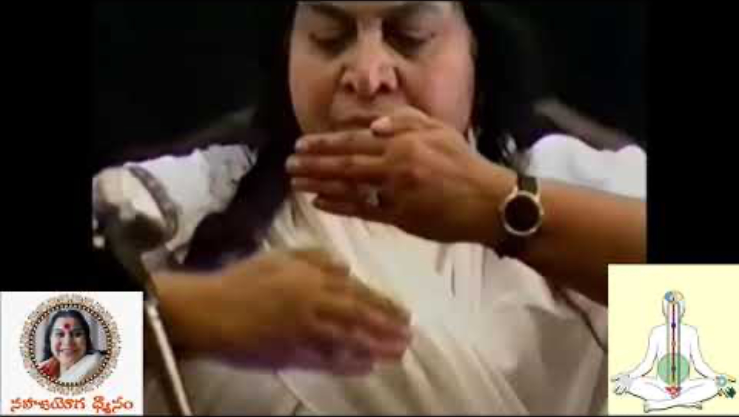
Bandhan
Bandhan means raising our Kundalini energy and creating a protection around us.
We should raise our kundalini and give bandhan every time before and after meditation.
We do this exercise with hands as guided in this video
Notes:
Bandhan is the process of raising our Kundalini energy and creating a spiritual protection around us. It is recommended to raise your Kundalini and give Bandhan before and after meditation. Let us watch the video.

Slide 11
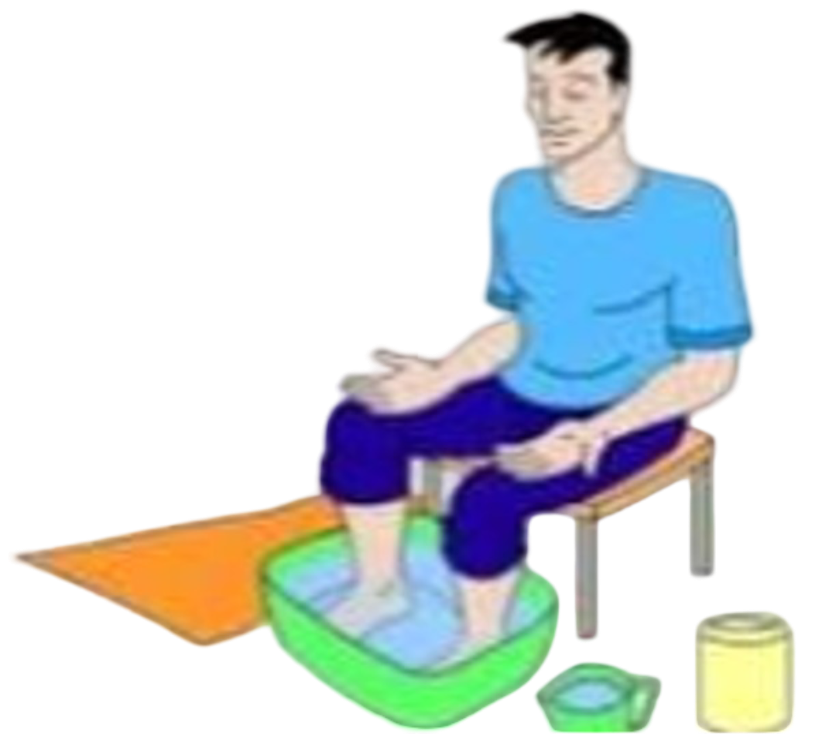
Foot - soaking
Foot-soaking is a method to cleanse our inner being using water element.
We light a candle in the room while doing this.
For best results, foot-soaking can be done in the night just before going to sleep.
Steps:
Fill a tub with clean water and add a handful of salt.
Keep a towel and a mug of fresh water ready.
Sit on a chair and give yourself ‘Bandhan’ to begin the meditation.
Soak your feet in the water for 10-15 minutes to cleanse your channels.
When you are done, wash your feet with freshwater and wipe them dry.
End the process by giving yourself Bandhan. Drain the used water down the toilet (as it contains impurities).
Notes:
There is also a simple technique in Sahaja yoga to cleanse our inner system using water called foot-soaking. To do this, we sit with our feet in a tub of clean water with salt added to it, for about 10-15 minutes to clear the channels. Afterward, wash and dry the feet, give Bandhan, and drain the water down the toilet as it carries away impurities.
It is the best if we can do this at night before going to sleep.

Slide 12
Collective meditation & References
Collective meditation is very important because we can feel calmness, easily improve our meditation, and learn techniques to keep us in balance.
To attend Sahaja Yoga collective meditation near your location, you can lookup ‘Sahajayoga <city/country> name’ in Google/Meetup.
This short introductory booklet gives you more details about Sahaja Yoga and how you can meditate everyday - Meditation-at-Home-Booklet
More information about Sahaja Yoga and center locations around the world can be found here:
sahajayoga.org
freemeditation.com
sahajayoga.org.in
Notes:
Besides our individual daily meditation, it is very important to meditate as a group. Collective meditation increases our calmness, improves our meditation, and helps us learn from others. To find a local collective, you can search for ''Sahajayoga along with your city/country's name'. More information is available on the listed websites and in the "Meditation-at-Home-Booklet" which can be downloaded by clicking the link.

Slide 13
Thank you!
Notes:
Thank you for listening!

